Slide 1
Lighting

Slide 2
8.0 Lesson 8 (&9&10) / demonstratie / toets
Programma les 8:
10min Uitleg Smart lighting
20 min Voorbeeld van Smart light
50 min voorbereidende werkzaamheden demonstratie op school t.a.v. van Smart Lighting
Les 9 (90min) Demontratie op school van Smart Lighting
Les 10 (90min) Afsluitende toets

Slide 3
Lighting
Lesson program Lighting 8

Slide 4
Index of lesson program
1. What is Lighting?
2. New technologies with regard to lighting
3. Designing lighting systems
The course will be concluded with a test

Slide 5

1. What is Lighting
Different kinds of light
Different types of lighting
Properties of lighting
Theory of lighting calculations

Slide 6
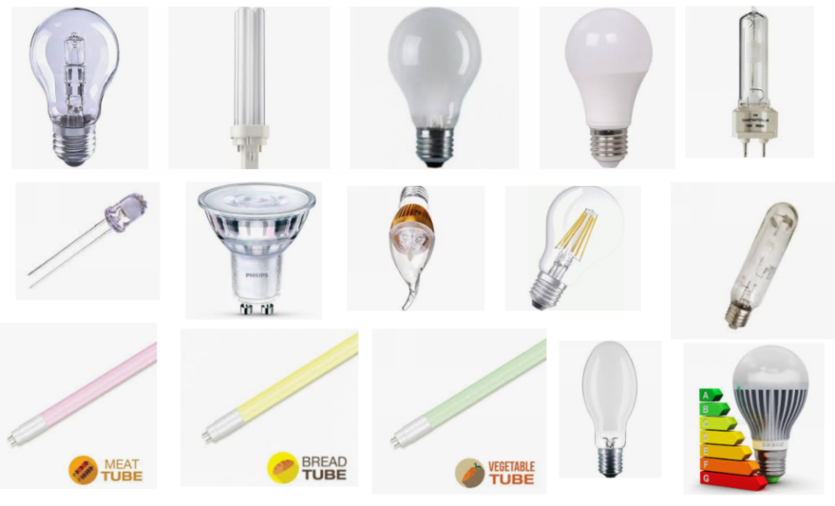
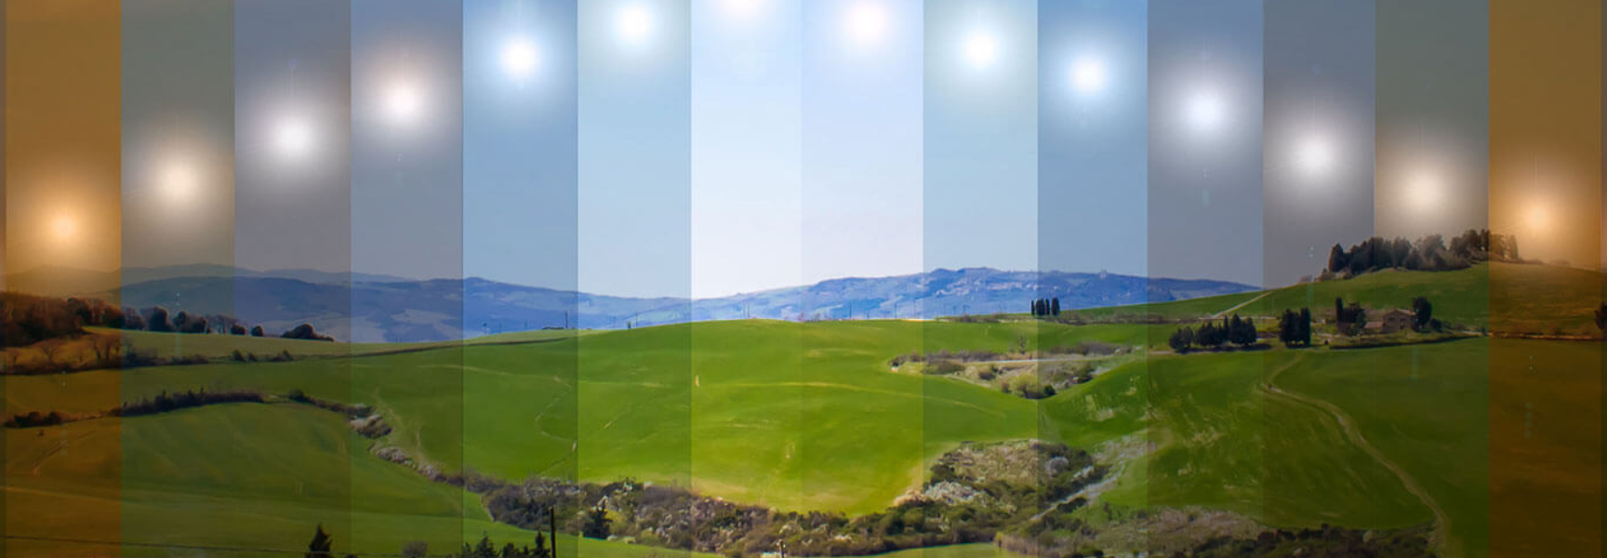
1. What is Lighting
Different kinds of light
History: Edison 1879

Slide 7
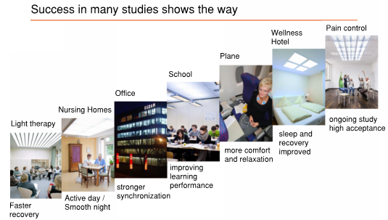
1. What is Lighting
Different types of lighting
HCL HuHCL= Human Centric Lighting (Ook wel biodynamische verlichting genoemd)

Slide 8
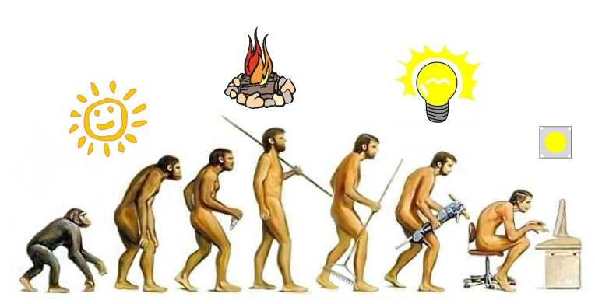
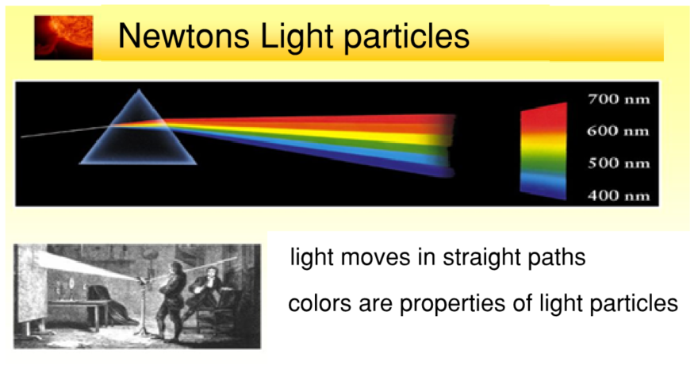
1. What is Lighting
Properties of lighting
Evolution of lighting
Light particles

Slide 9
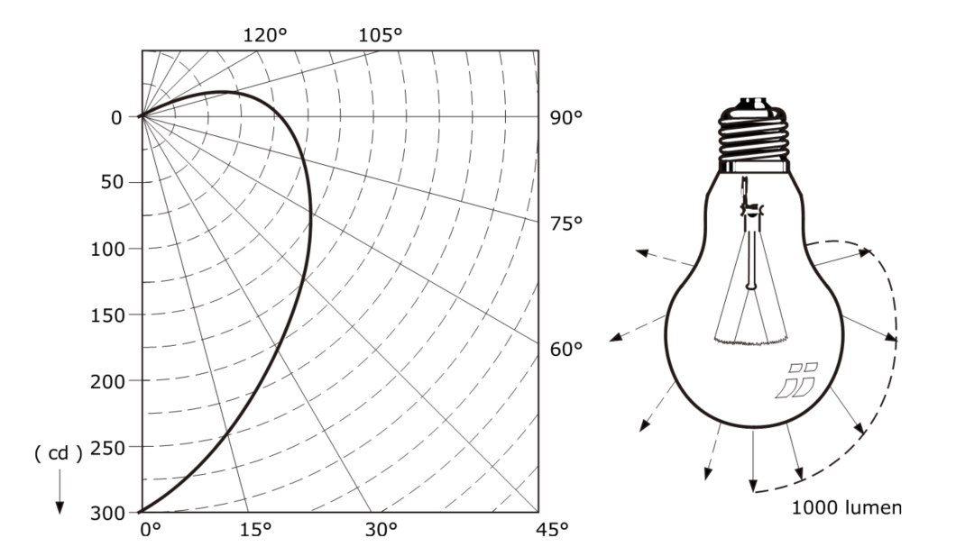
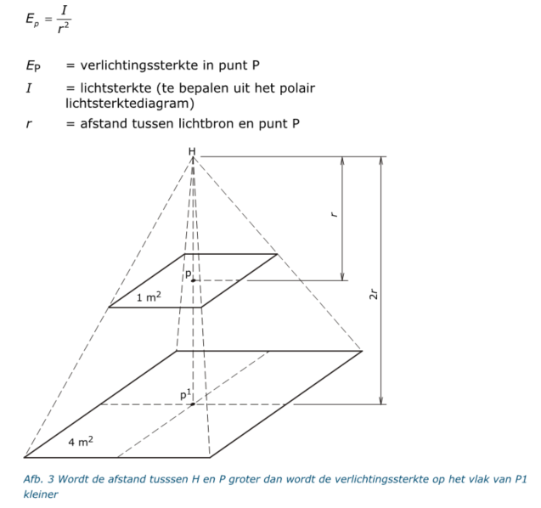
1. What is Lighting
Theory of lighting calculations
Light intensity diagram

Slide 10

2. New technologies with regard to lighting
Smart lighting
Lighting control systems

Slide 11
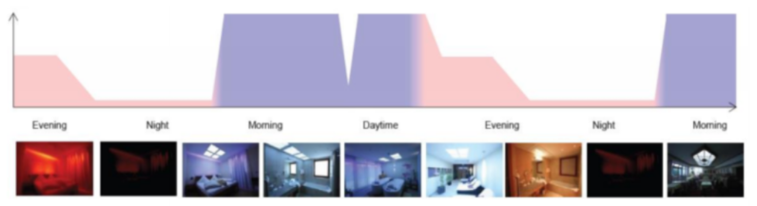
2. New technologies with regard to lighting
Smart lighting

Slide 12
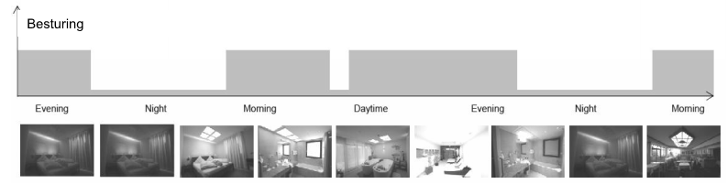
2. New technologies with regard to lighting
Lighting control systems

Slide 13

3. Designing lighting systems
Light calculation programs
Energy management
Light applications for different types of buildings

Slide 14
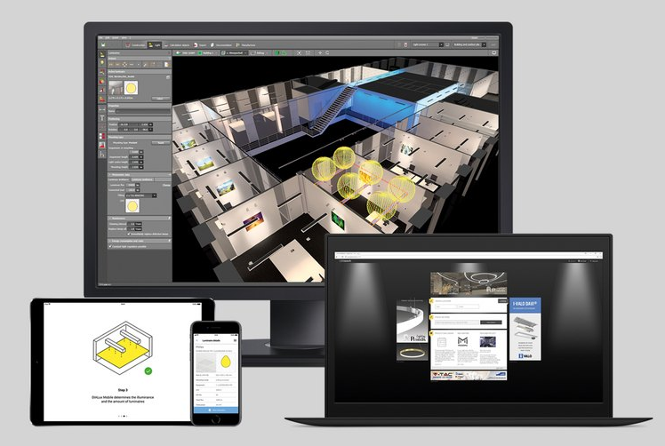
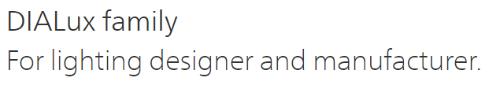
3. Designing lighting systems
Light calculation programs
free DIALux software

Slide 15
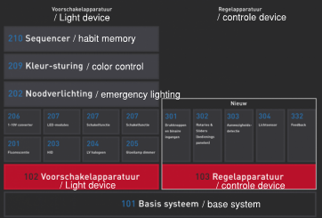
3. Designing lighting systems
Energy management
Dali system: Digital Addressable Lighting Interface
Dali-2 bi-directional interface for feedback to the light management system
Sequencer: habit memory

Slide 16

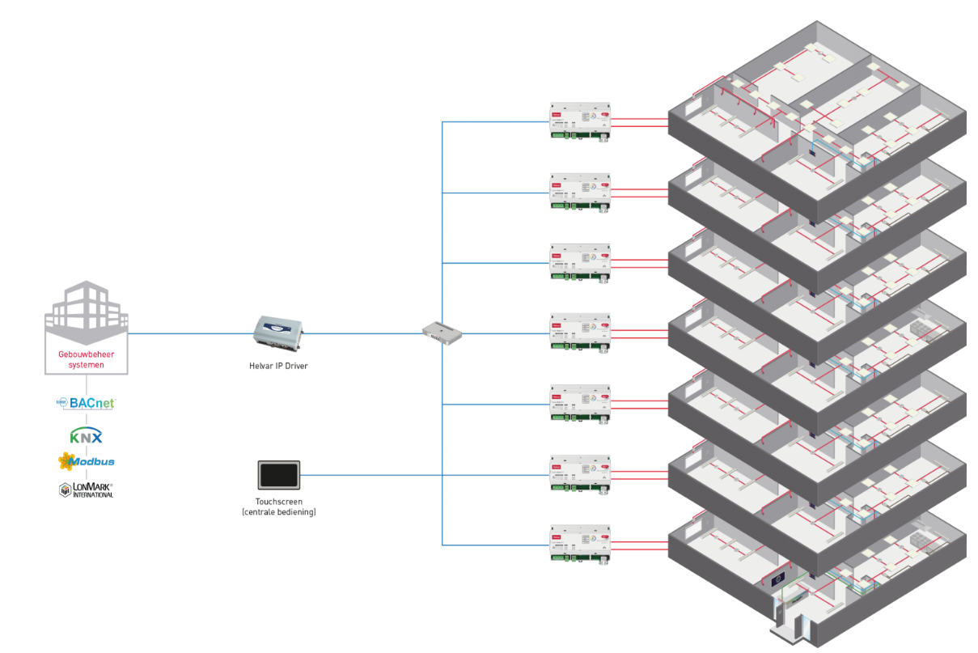
3. Designing lighting systems
Light applications for different types of buildings
Visualization of the installations
Integration of different installations
Monitoring of emergency lighting
Computer programming with Design software
Manual operation: with ASCII codes (American Standard Code for Information Interchange) and Apps

Slide 17
End lesson 8
50 min + 90 min (140 min)
Maak een plan in uitvoering hoe je andere studenten kennis kan laten maken met Smart Lighting. Ga in overleg met de docent welke materialen je nodig hebt om dit te kunnen laten zien / tonen
Ga in overleg met de school of je een ruimte in kan richten om deze nieuwe technieken van verlichting kan tentoonstellen.
Misschien kun je samenwerken met andere afdelingen, denk bijvoorbeeld aan design&interieur- en/of hout & meubel studenten.
Maak er wat moois van!

Slide 18
Lesson 9 (90min)
in progress / voorbereiding demontratie op school van Smart Lighting

Slide 19

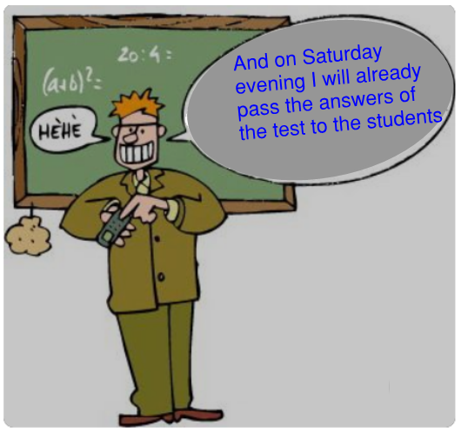
The course will be concludes with a test work
Lesson 10 (90min)

Slide 20
Einde les

